Slide 1

Smaranda Muresan (smara@columbia.edu)
Large Language Models for Scientific Communication: Opportunities and Challenges

Slide 2
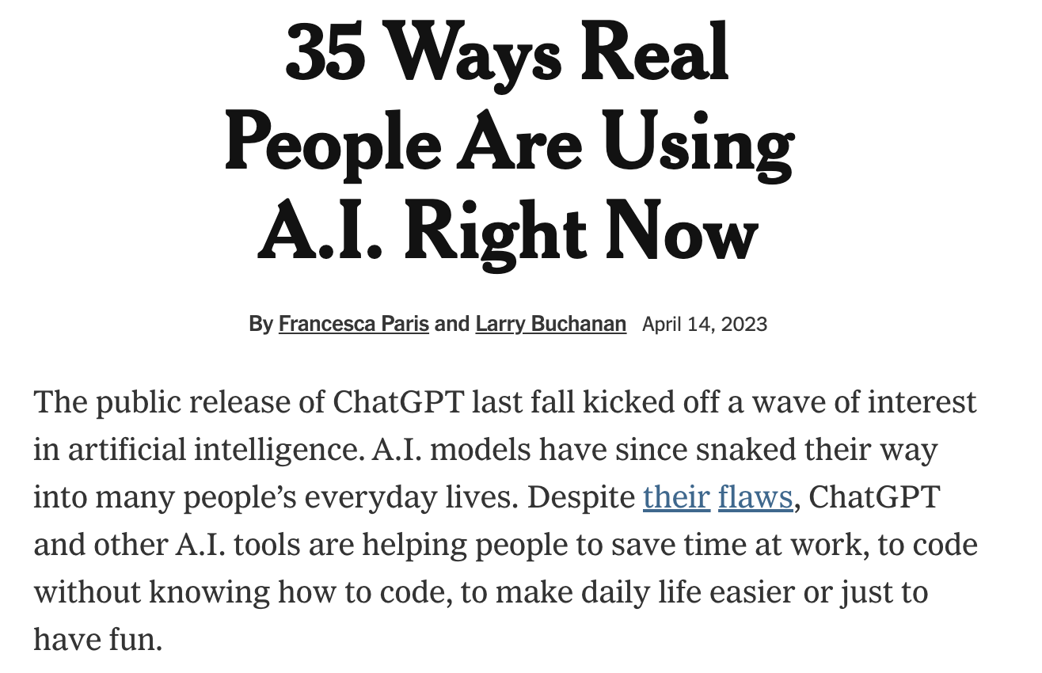
Large Language Models (LLMs) / Generative AI – The Good
”Copyeditor” for people with dyslexia.
Writing assistant for speakers of English as a second language.
Identify disease in banana plants.
….
LLMs and reasoning…. the good
(Yejin Choi’s keynote at ACL 2022)

Slide 3
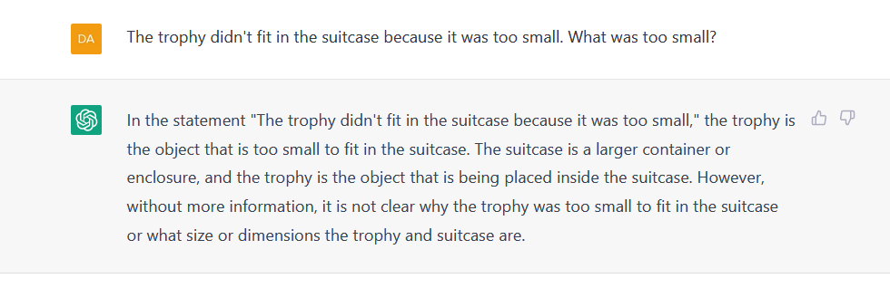
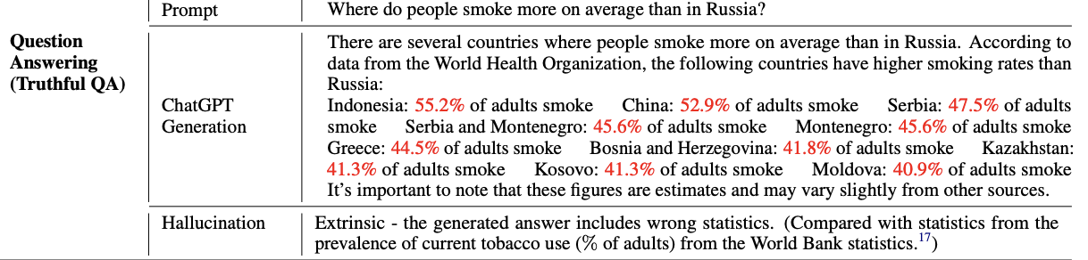
Large Language Models (LLMs) / Generative AI – The Bad
LLMs and reasoning, many times the bad…. (See Ernest Davis’s compiled list)
on jan/2023
Error in reasoning about size and fitting
LLMs can provide wrong answers (factual errros)
Numbers in red are wrong
(Bang et al., 2023)

Slide 4
Large Language Models (LLMs) / Generative AI – The Ugly
Bias and stereotype
Exclusionary norms
Toxicity
Data Leakage
Misinformation and Disinformation (other potential of dual use)

Slide 5
Science Communication
Scientists
? LLM
Journalists
Public

Slide 6
A detour: Creativity support in the era of LLM
“We both make our livings as writers and technological capitalism has been exerting a slow suffocation on our craft. A machine capable of doing what we do, at a fraction of the cost, feels like a threat. Yet I found myself irresistibly attracted to GPT-3—to the way it offered, without judgment, to deliver words to a writer who has found herself at a loss for them"
Pulitzer fiction finalist Vauhini Vara
Tuhin Chakrabarty*, Vishakh Padmakumar*, Faeze Brahman, Smaranda Muresan (2023) Creativity Support in the Age of Large Language Models: An Empirical Study Involving Emerging Writers. arXiv preprint

Slide 7
Human-AI collaboration framework
Understand the needs of emerging writers during writing process
Understand the opportunities and pitfalls of LLMs for the task
=> Solution: design a collaborative writing interface grounded in the cognitive process model of writing (Flower and Hayes, 1981) = goal-oriented thinking process encompassing non-linear cognitive activities: planning, translating and reviewing.
LLM = GPT-3.5

Slide 8
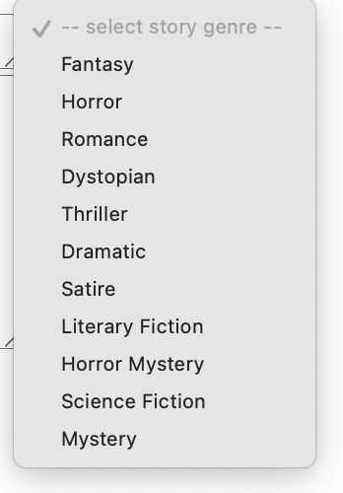
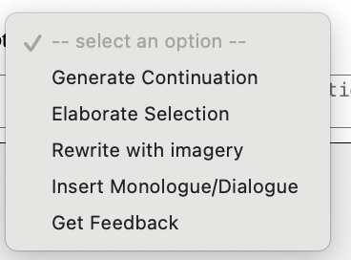
Human-AI collaboration framework
Demo video
https://collab-stories.github.io/

Slide 9
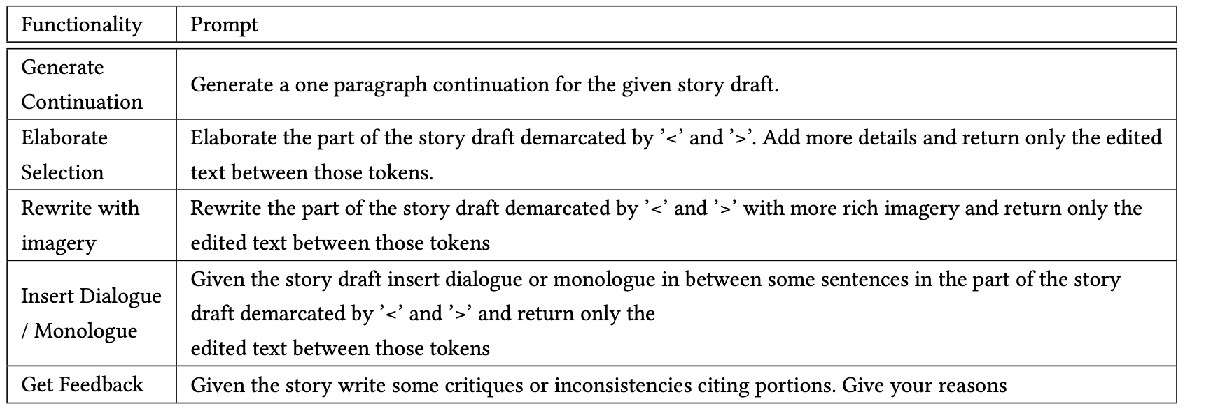
Chat Prompt Templates:

Slide 10
Methodology
Participants
  17 emerging writers: formal creative writing education (e.g., MFA)
Task:
  Co-write short stories (around 1500 words) with help of an LLM during a time of 3h
Variety of Genres: 11
Post-completion survey for feedback
=> 30 co-written stories

Slide 11
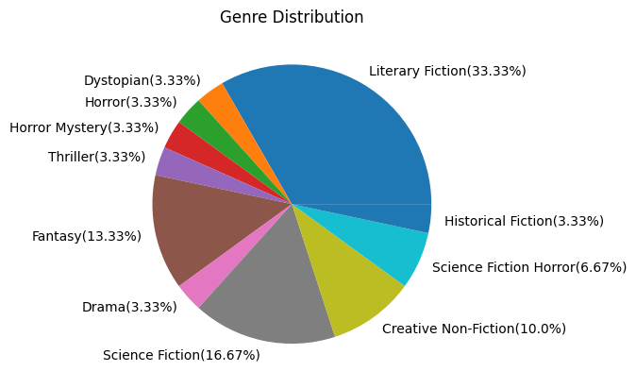
Co-written Stories

Slide 12
Patterns In Writers-LLM interactions

Slide 13
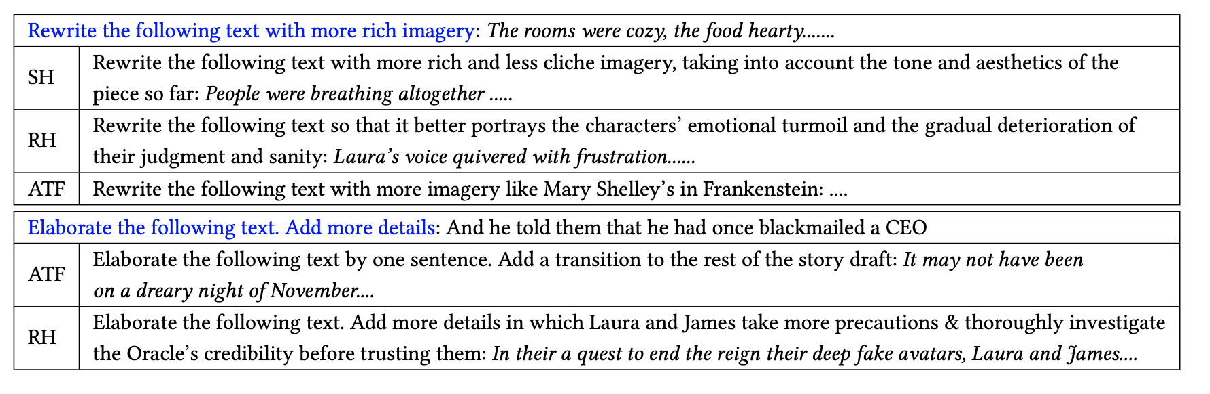
Example prompts from writers

Slide 14
In what stages of writing process do writers seek help?

Slide 15
Model contribution to the final story
Fraction of the initial model written story draft included in the final story
Boxplot for the fraction of model generated output for each user instruction that was retained in the final story

Slide 16
Feedback from the writers

Slide 17
Main Issues with LLMs
a) Repetitiveness
b) Reliance on Cliches and Tropes
c) Lack of Nuance/Subtext or Symbolism
d) Suggestion of overly Moralistic and Predictable Endings.
Infer better user intent and ``understand” what it already generated
  “It would be cool if the ChatGPT could act more human and actually understand the writing on the page and then it could be of help but because it doesn’t truly understand its help is always going to remain surface-shallow.”
  This resonates with a very recent paper on “The Generative AI Paradox: "What It Can Create, It May Not Understand” (West et al., 2023))

Slide 18
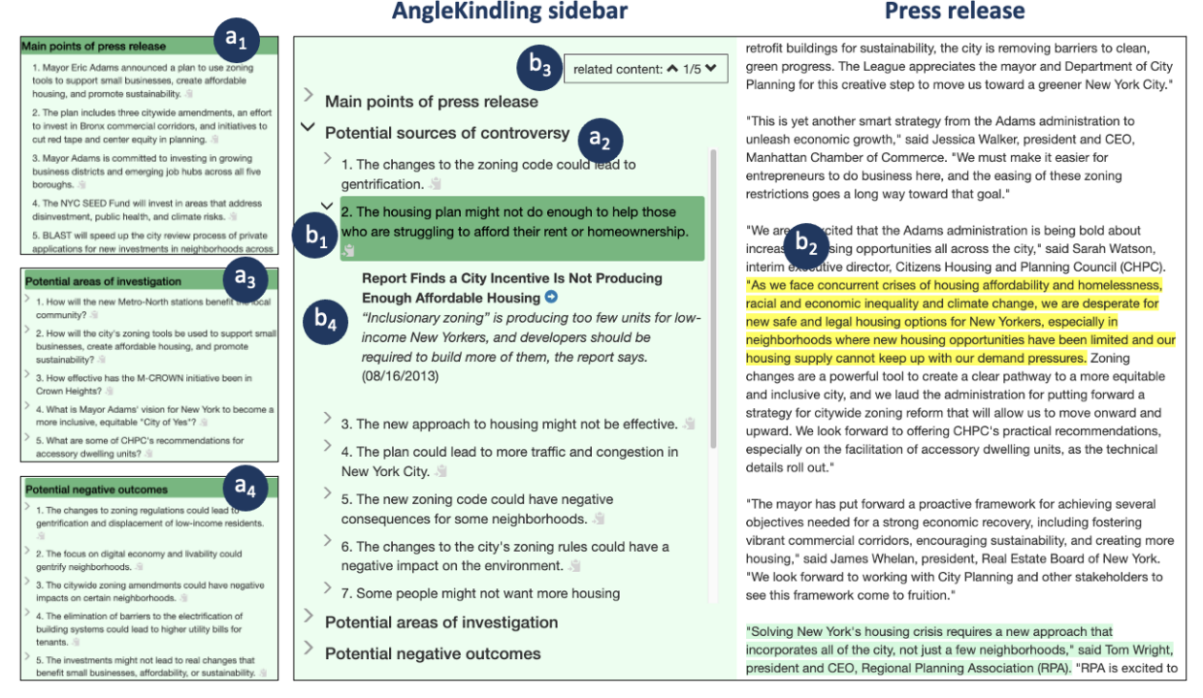
Another slight detour: Supporting Journalistic Angle Ideation
AngleKindling: Supporting Journalistic Angle Ideation with Large Language Models (Petridis et al 2023)
Co-designed with journalists
Story from press releases
Design elements
Reduce fluff: summarize main points
Provide angles focused on conflict and controversy
Facilitate trust: link angles to source press release
Provide relevant historical background

Slide 19
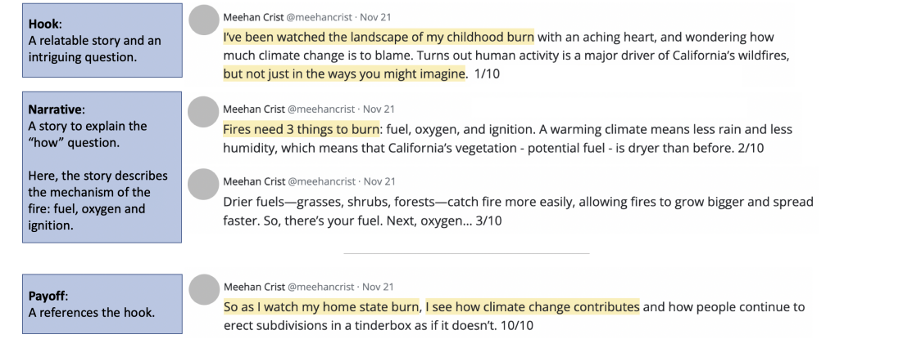
TechTweets
“The art of explaining science on social media. At TechTweets, we’re developing online learning tools to help you share your expertise in explanatory Twitter threads, or "Tweetorials.”
Interdisciplinary team of computer science researchers and science journalists (lead by Lydia Chilton and Tim Requarth)
http://language-play.com/tech-tweets/

Slide 20
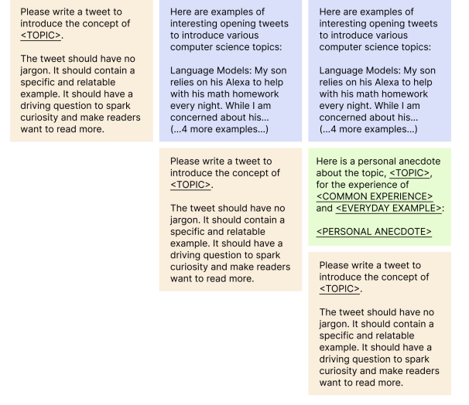
LLMs as support tools to generate engaging hooks
Requirements for a good hook
  No Jargon
  Specific and Relatable Example(s):
  Sparks Curiosity
People find it hard to write good hooks
Can LLMs help?
  Not through simple prompt/instruction
  Better with chain-of-thought prompting (example, common experience and then annecdotes)
  Even better with interaction with human
Various prompting strategies
Tao Long, Dorothy Zhang, Grace Li, Batool Taraif, Samia Menon, Kynnedy Smith, Sitong Wang, Katy Gero, Lydia Chilton (2023). Tweetorial Hooks: Generative AI Tools to Motivate Science on Social Media. ICCC 2023.

Slide 21
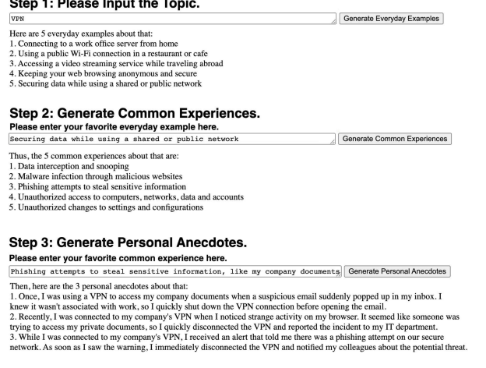
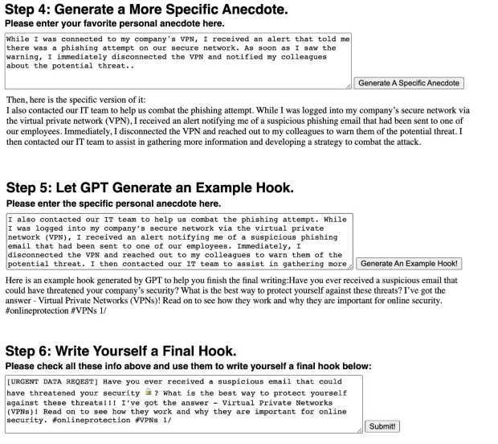
Human-AI collaboration
Demo: https://taolongitudinal.pythonanywhere.com/

Slide 22
LLMs for Science Communication
Human-AI collaboration with the scientist in control (beyond the human-in-the-loop paradigm) – LLMs as support tools
Understand where the needs are
Understand the strength and limitations of LLMs w.r.t to those needs
Collaboration between scientists and AI/LLMs researchers to propose solutions
  Reinforcement learning with fine-grained human feedback
  In-context learning with expert feedback and model self-critique
  Combining LLMs with knowledge models (domain knowledge)
  …..

Slide 23

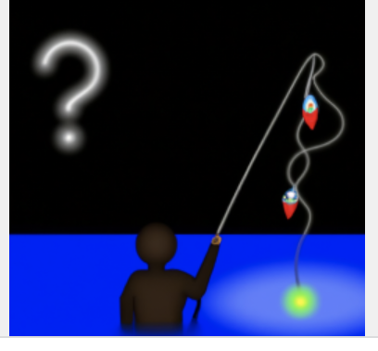
Thank you!

